Slide 1
Project Title: Creating a Bot to Play Ticket to Ride
Group members: Cameron Ake
Date: 9/26/2023
Period: 4
Milestone: Must have decided the project by now

Slide 2
Problem
I want to make a bot to play Ticket to Ride!
Strategy board game! (will explain overview of the mechanics soon)
Generally, playing friends online isn’t feasible; playing in-person takes an hour, so playing a bot is usually the most feasible option to do

Slide 3
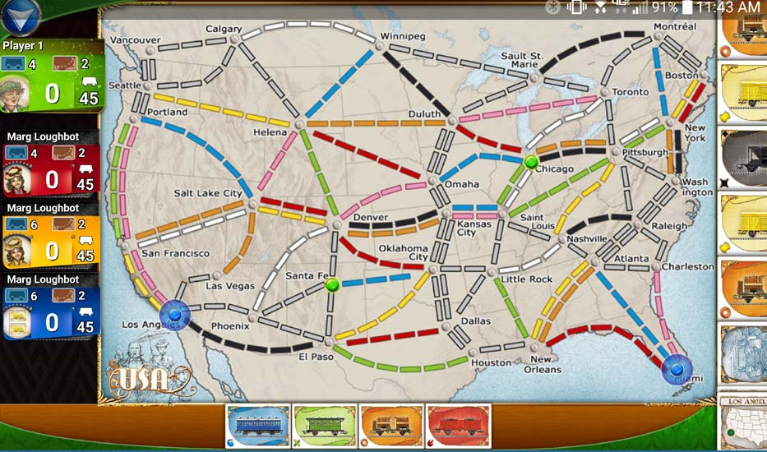
BACKGROUND
Ticket to Ride App
Game mechanics (basic overview)
Drawing cards
Tickets
Playing trains
Earning points
Game end
Image from https://oneboardfamily.com/app-review-ticket-ride/

Slide 4
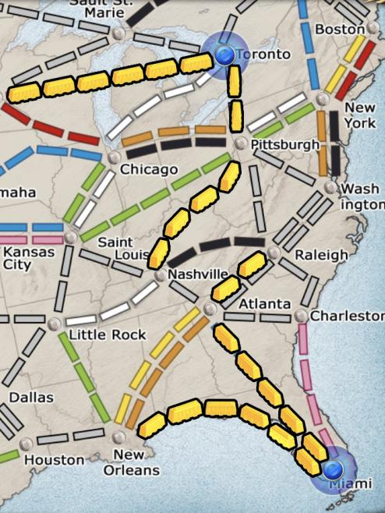
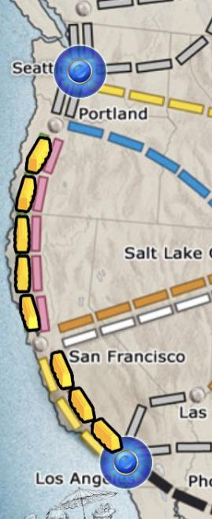
OTHER SOLUTIONS
Current Ticket to Ride bots
Don’t take necessary routes
Generally make transparently bad decisions, even late-game
Previous implementations:
Paper: “reinforcement learning for this is bad”
Java implementation posted on GitHub
Improper implementation of connections
Someone on Reddit coded some functionalities and basic strategies but not anything in terms of learning strategy

Slide 5
Why IS Ours BETTER?
Detailed earlier
Could use varying parameters to simulate different strategies and have many iterations of bots play against each other to actually “learn” good strategies (develop them on their own)
Haven’t hashed out exact algorithm yet; I’ve focused more on creating the functionality of the game so far

Slide 6
Novelty
New implementation (nobody has made a bot as advanced/learned as I plan to)
Better (hopefully) bot!
More often that the bot wins compared to the lackluster current bots

Slide 7
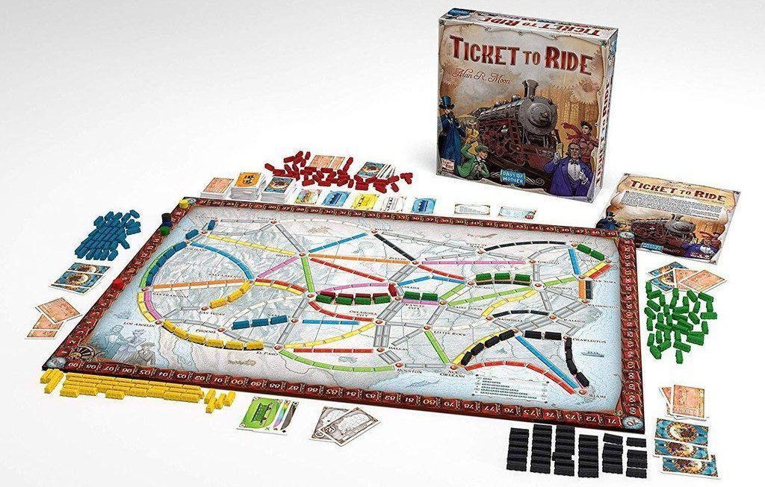
ImPACT
More ability for Ticket to Ride players to develop their abilities and enjoy the game by playing challenging bots
More ability to play Ticket to Ride overall; current options are complicated board setup or $10 mobile game
More development in terms of the possibilities of artificial intelligence for complex games

Slide 8
METHOD
First, code the functionality of the game and be able to play (make a bot that acts randomly, test these things)
Then, create algorithm to pit bots against each other and choose the best parameters for decision-making
Potentially, genetic algorithm-esque: generate new bots based on the bots that worked well each time the bots are pitted against each other
Maybe: selecting bots with clearly different “strategies” for some variety
Then, make website to implement if I have time? (very unsure how long middle part will take)

Slide 9
METHOD: Systems Architecture
Input:
Initial state of board
Cards
Tickets
Strategy parameters for each bot
During:
Graph for routes
Dictionary for cards in hand
Graph search (smallest route)
Strategy parameters
repeat!
Output:
Moves (state of board each turn)
Winner and points
In-between:
Which bots did best?
Adjust parameters for bots
New match between bots

Slide 10
RESULTS
Data structures done!
RandomBot is (kinda) done - I made it take every type of action but I haven’t actually had it play full games yet
No other results; it hasn’t been too long

Slide 11
Limitations
As mentioned prior, unlikelihood of reinforcement learning being effective
Difficulty of making website; new territory if I get to that point

Slide 12
CONCLUSION AND FUTURE WORK
Going well so far!
Next steps:
Make code to play through an entire game, supervise, ensure RandomBot works properly
More research on potential algorithms to use
Functionality to have player play against bot
Test with RandomBot

Slide 13
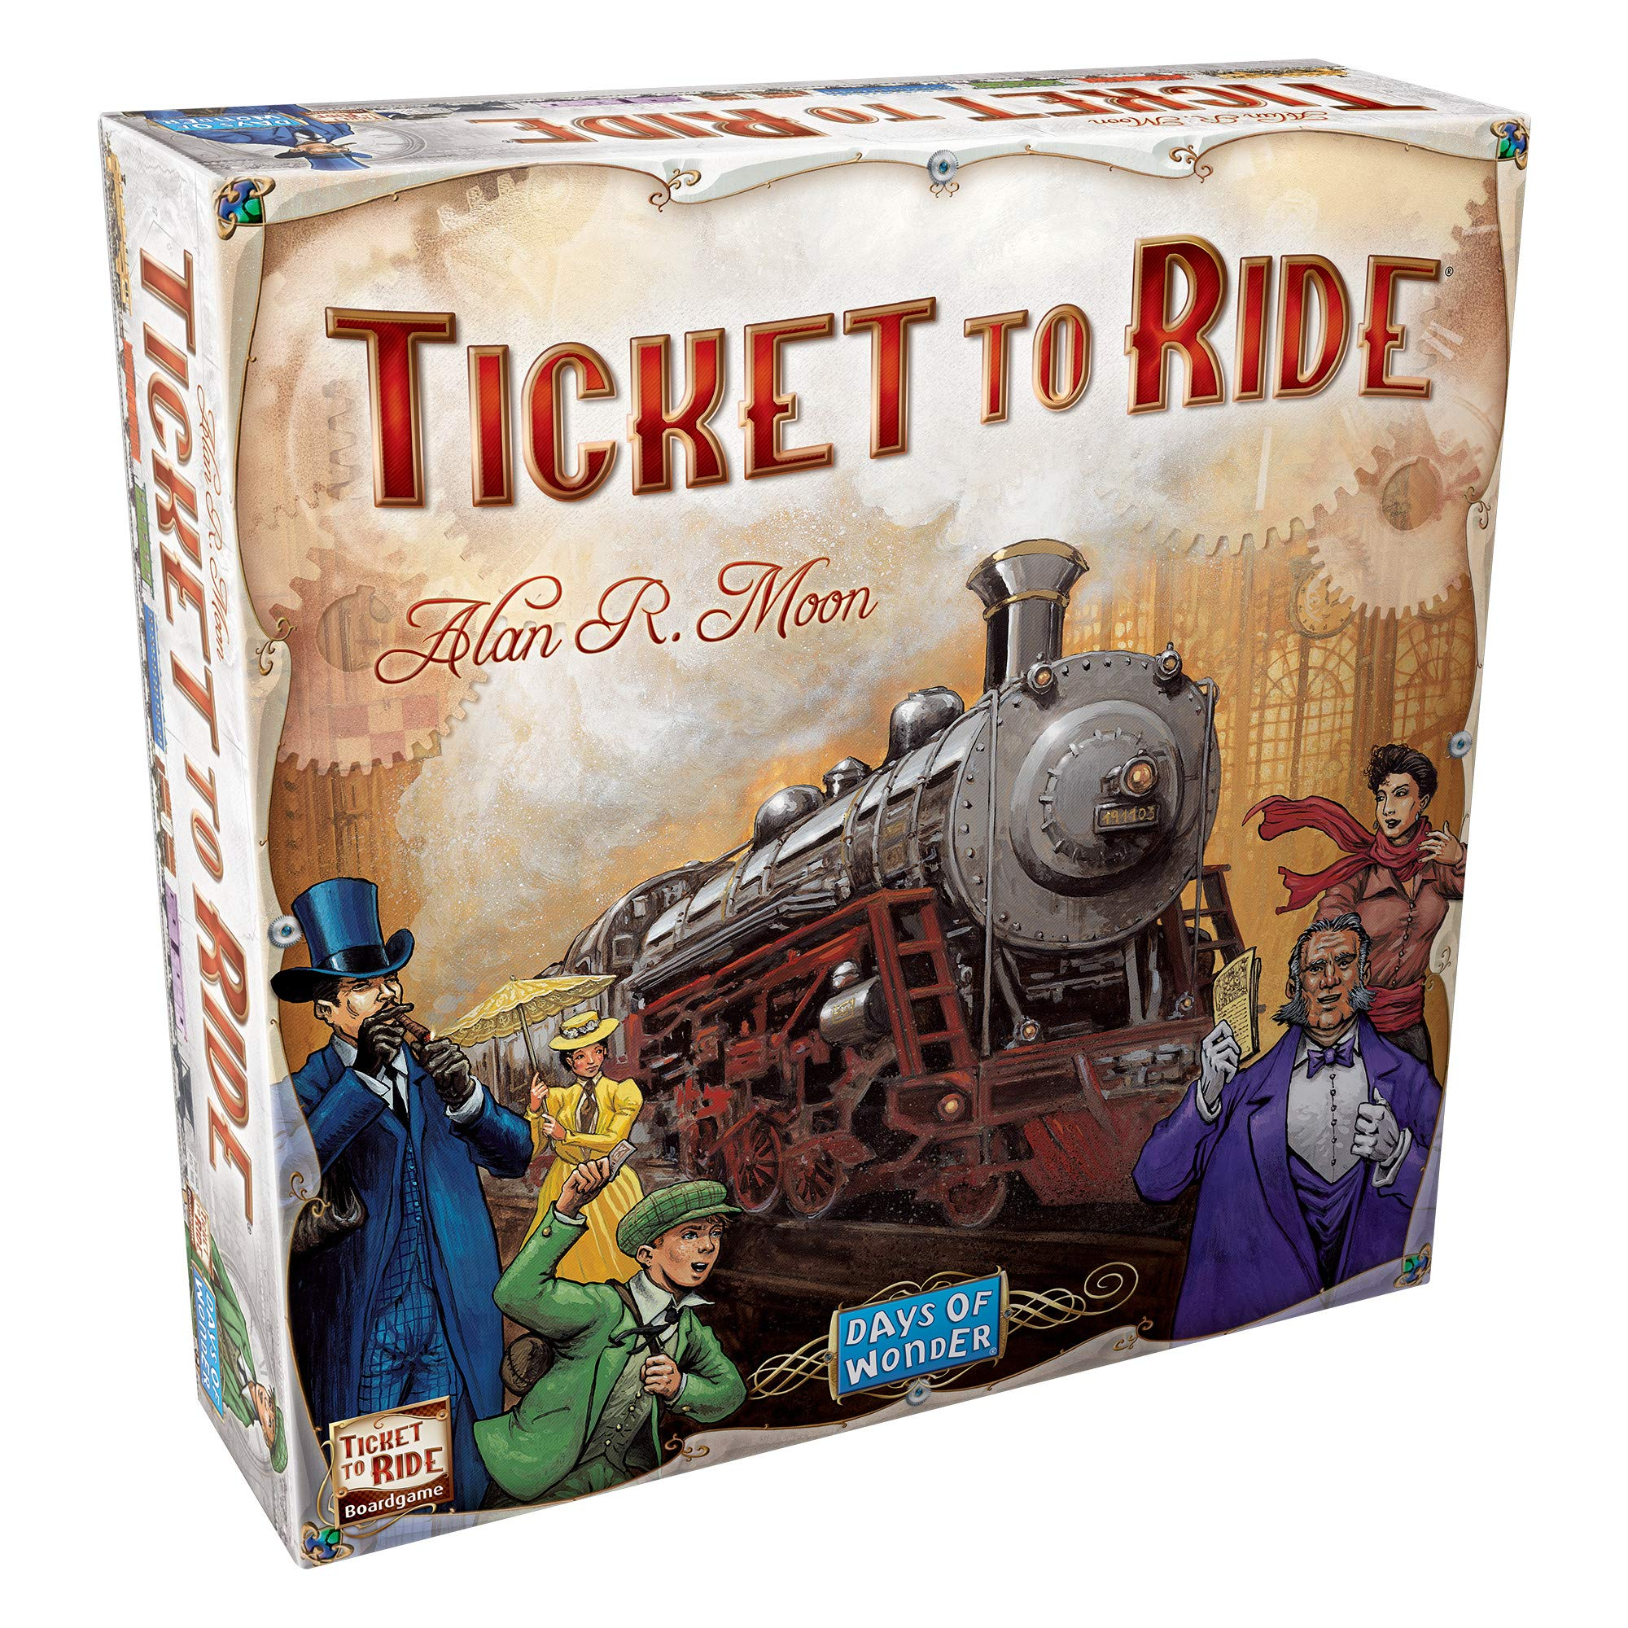
Q&A
Thanks!
Questions?

Slide 14
Demo (If you are building on an existing project)
(i am not building on an existing project)

Slide 15
REFERENCES
Ticket to Ride app from Days of Wonder on App Store
Stack Overflow for Python tips (most notably, sorting out data structures and classes in different files)
Destination ticket data from Fandom
Reinforcement Learning Is Bad For TTR paper (Daniel Dinjian & Cuong Nguyen, from Tufts University)
Reddit Person Who Made More Basic Bot
Github With Bad Information

Slide 16
THANKS!

